Slide 1
Double strap antenna

Slide 2
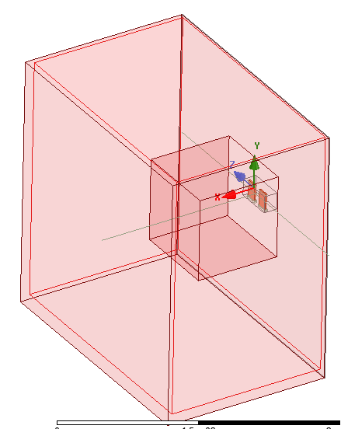
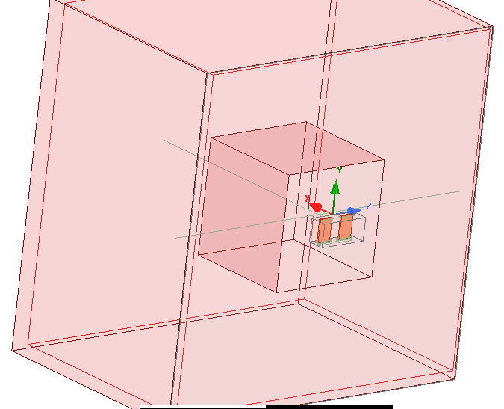

Slide 3
Equivalent dielectric
x_plasma=0.01
@50 MHz, 3 T
K_D = 14.17
K_D = 66.86
K_D = 132.72
 |  | 1e18 | 5e18 | 10e18
ANTITER | R_A (ohm/m) | 0.017 | 0.74 | 3.50
 | Z11 = Z22 (ohm) | 0.218 + i23.31 | 1.68 + i23.52 | 2.62 + i22.39
 | Z21 = Z21 (ohm) | 0.215 + i3.42 | 1.53 + i3.49 | 1.92 + i2.08
HFSS equivalent dielectric | R_A | 0,0175 0,014 0,022 | 0,49 | 2,32 2,35
 | Z11 | 0,13+j19,6 0,12+j19,6 | 0,71+j20 | 1,48+j20,4
 | Z12 | 0,130+j3,53 | 0,65+j3,81 | 1,23+j3,7

Slide 4
Cold Plasma
 |  | 1e18 | 5e18 | 10e18
ANTITER | R_A (ohm/m) | 0.017 | 0.74 | 3.50
 | Z11 = Z22 (ohm) | 0.218 + i23.31 | 1.68 + i23.52 | 2.62 + i22.39
 | Z21 = Z21 (ohm) | 0.215 + i3.42 | 1.53 + i3.49 | 1.92 + i2.08
HFSS cold plasma | R_A
 | Z11
 | Z12

